Slide 1

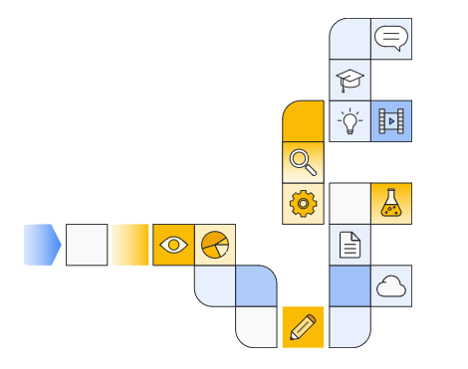

Google cloud generative ai overview Part 4
Notes:
https://www.cloudskillsboost.google/paths/118/course_templates/388

Slide 2
Vertex ai Search with Generative Ai
Notes:
https://www.youtube.com/watch?v=9CHxy52oo_o

Slide 3
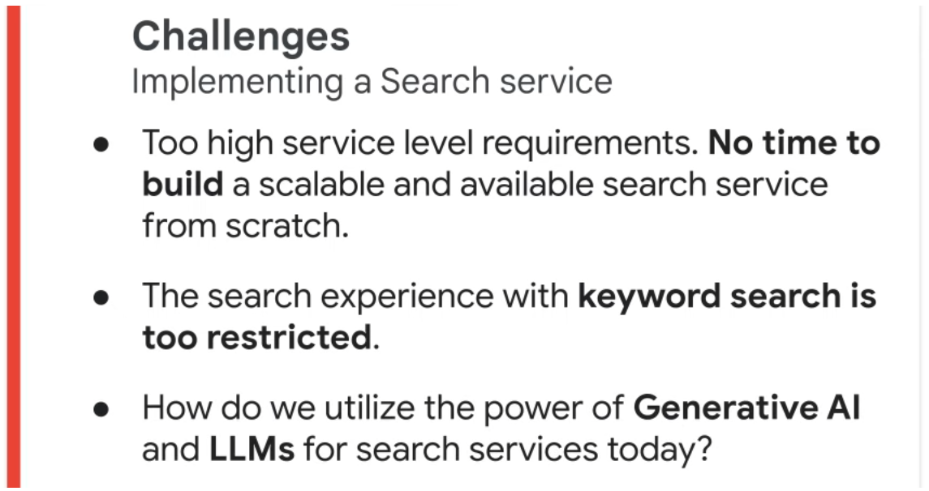

Slide 4
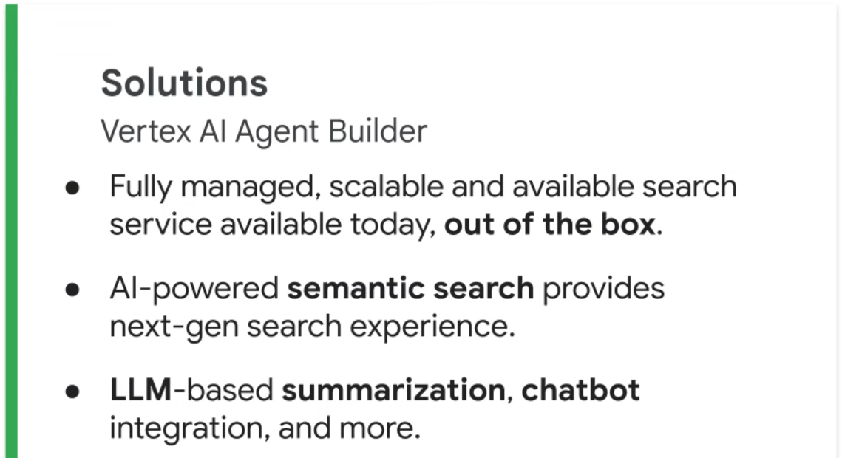

Slide 5
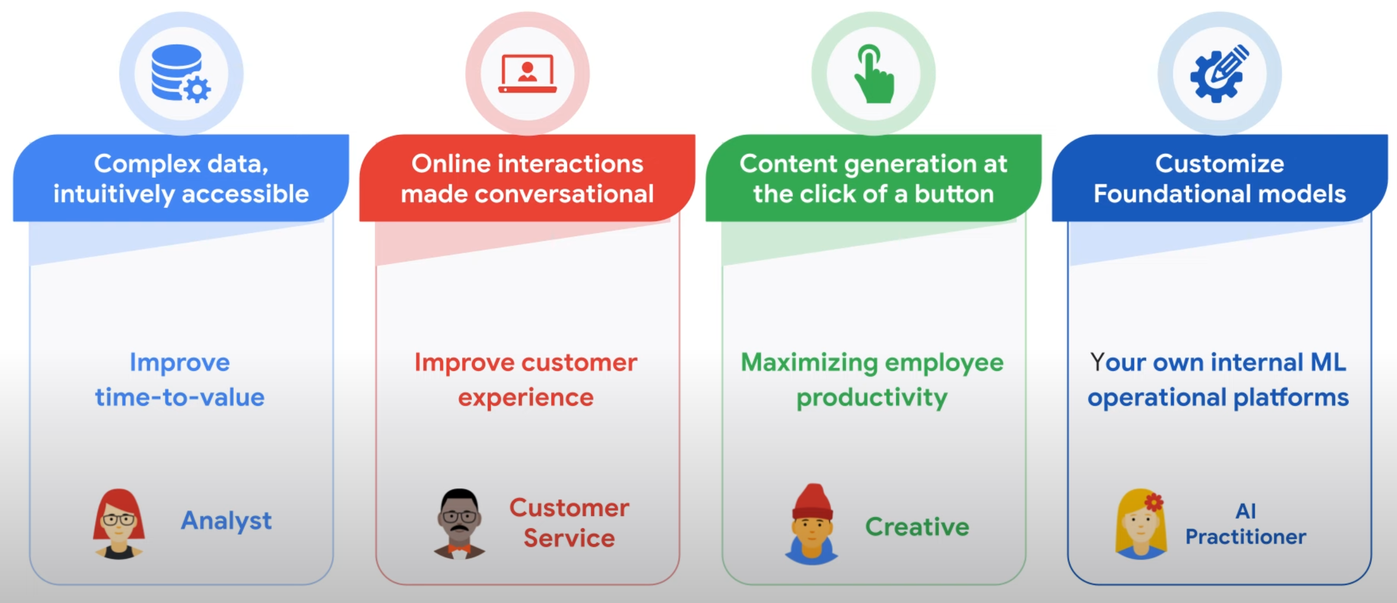

Slide 6
Generative ai Use Cases vertex ai search
Notes:
https://www.youtube.com/watch?v=YEVoeA_KZSI
https://www.youtube.com/watch?v=PWz35QJlYD0
https://www.youtube.com/watch?v=huXfhCeTeVc

Slide 7
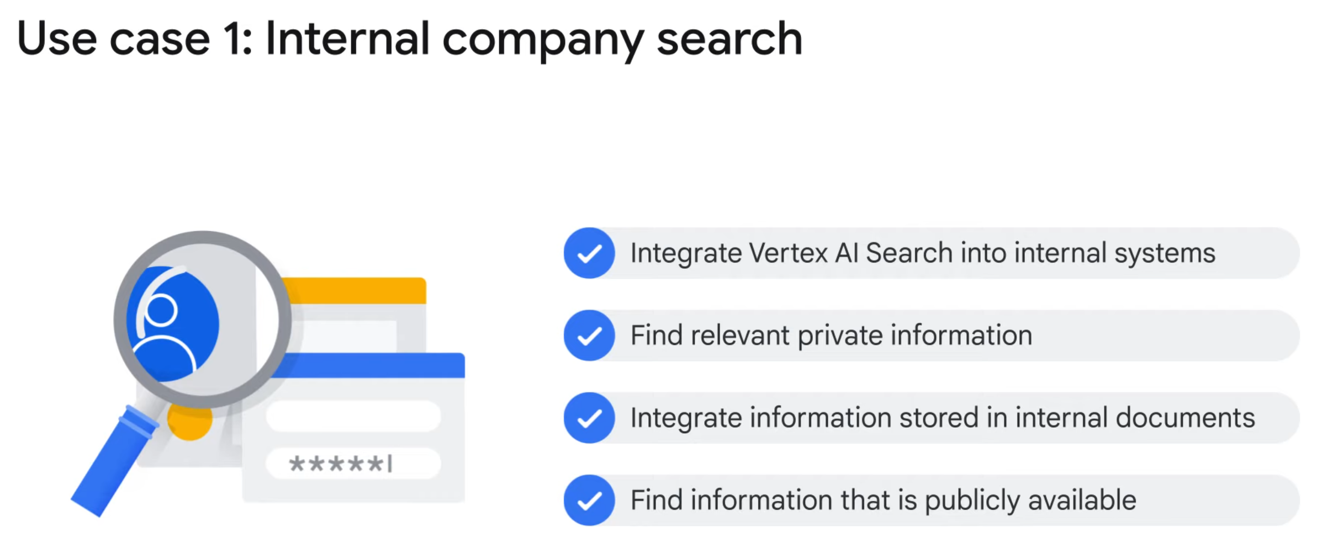

Slide 8
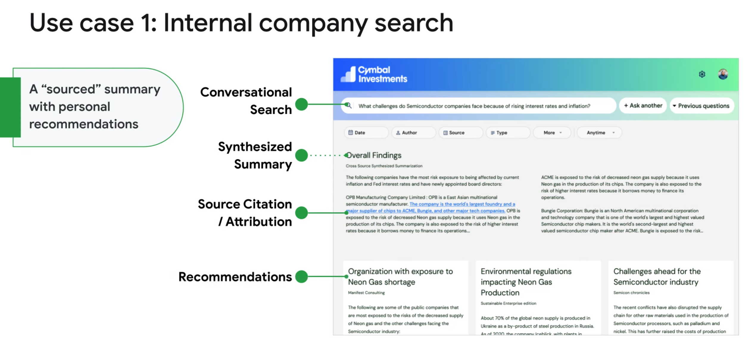

Slide 9
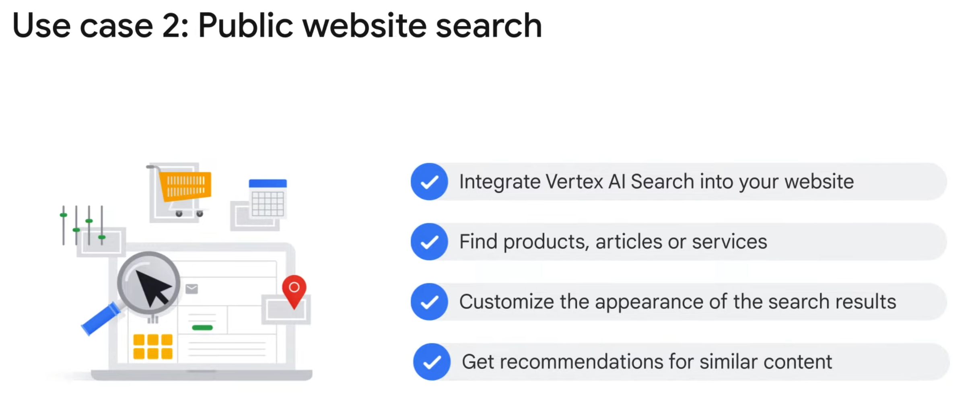

Slide 10
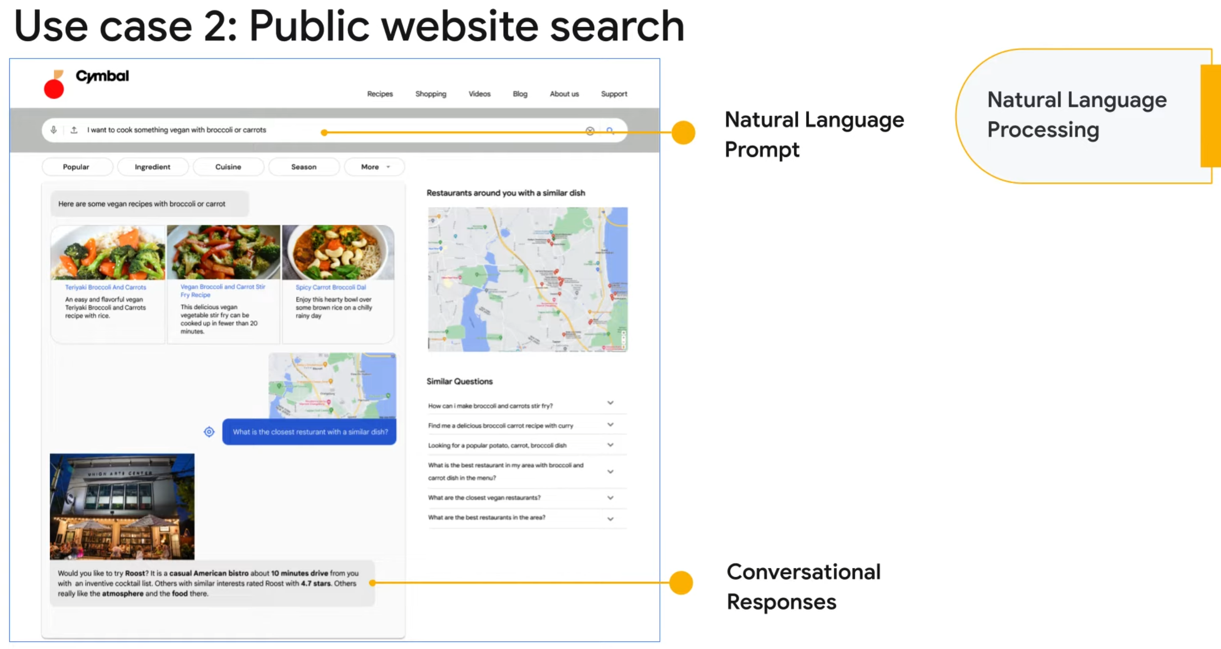

Slide 11
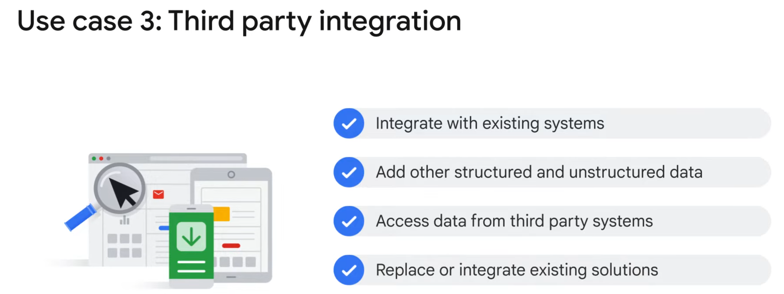

Slide 12
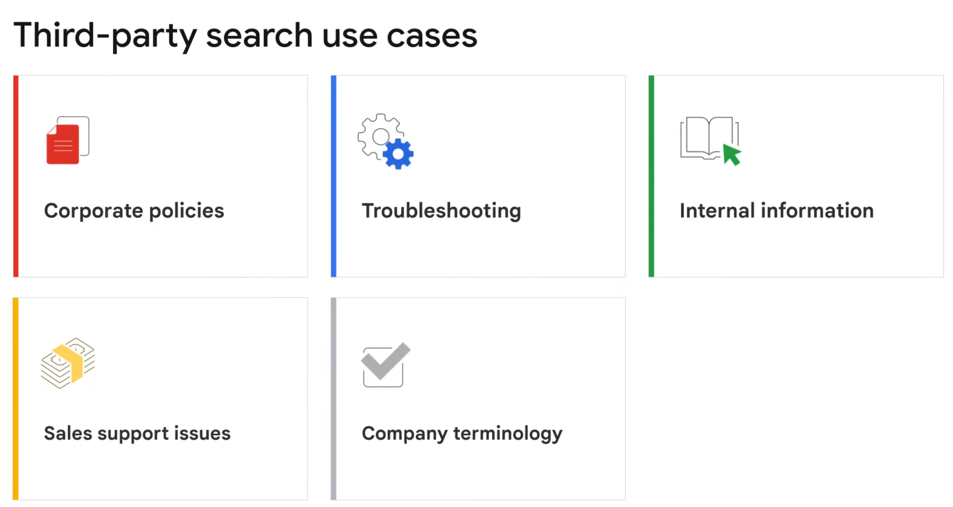

Slide 13
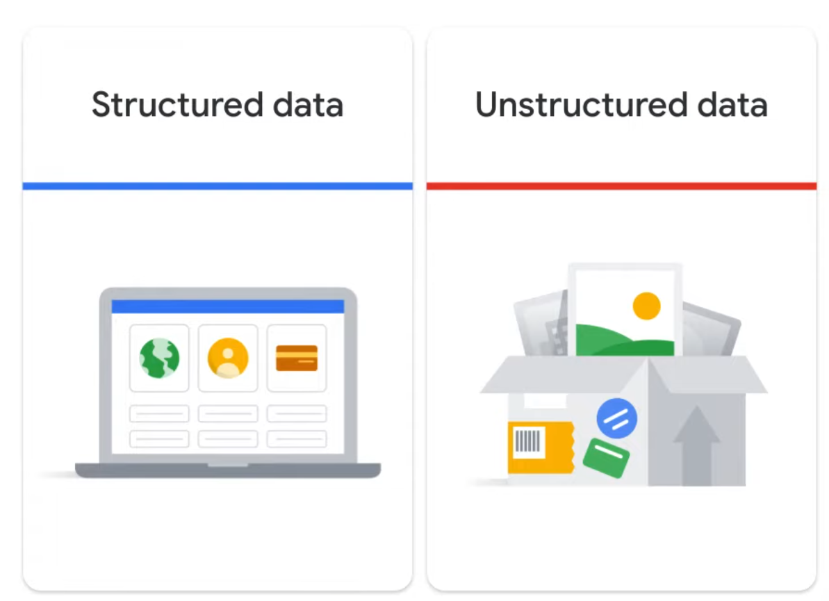

Slide 14
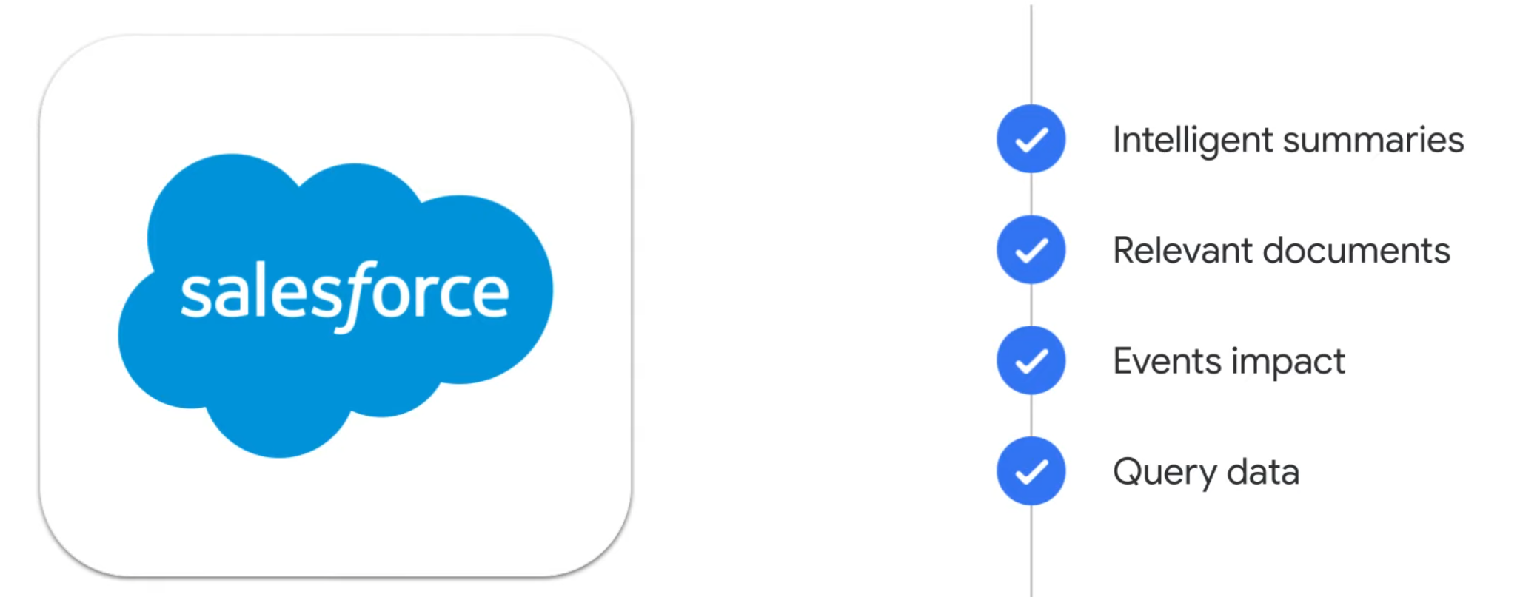

Slide 15
Google workspaces Cloud Search

Slide 16
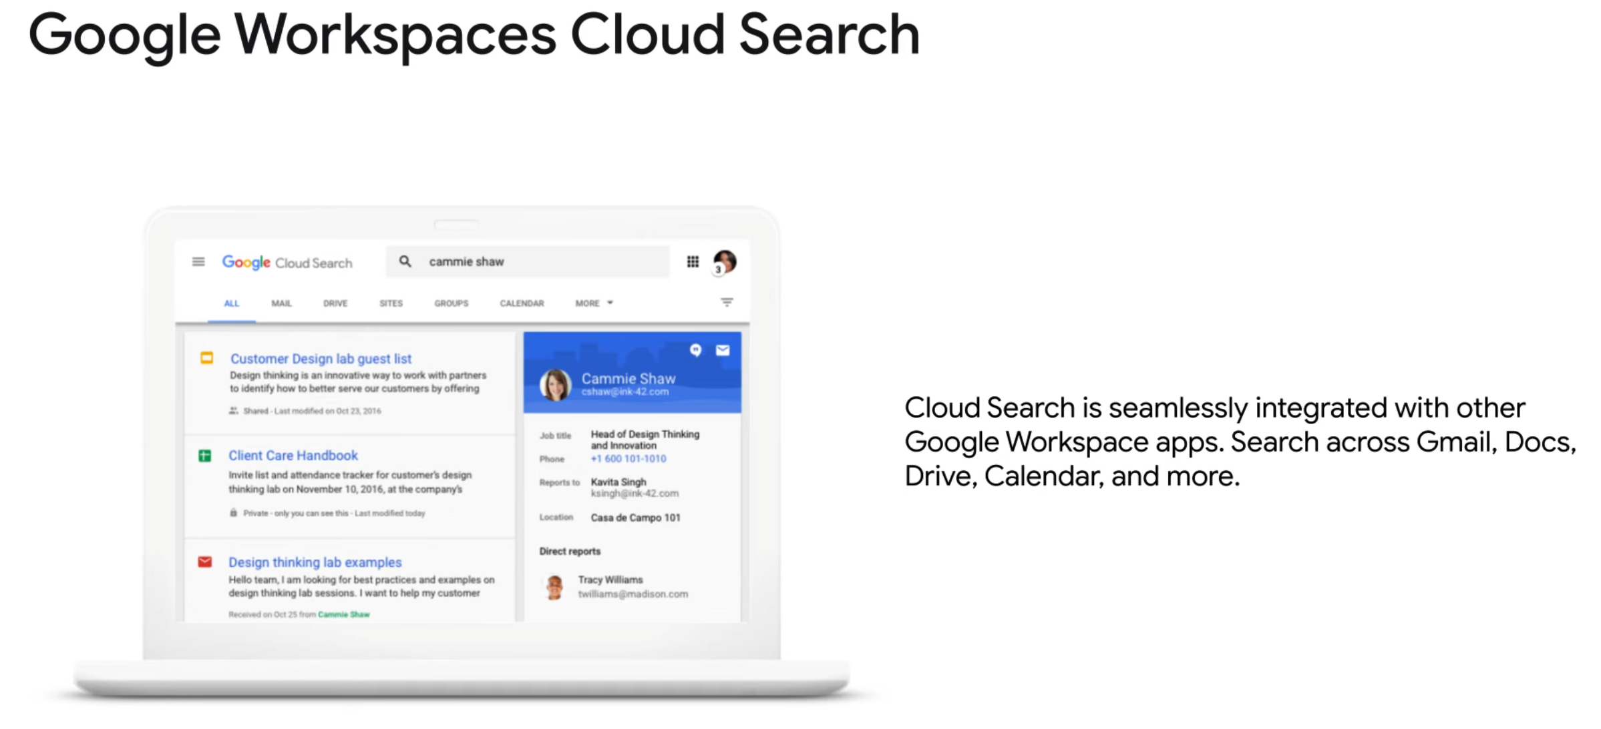

Slide 17
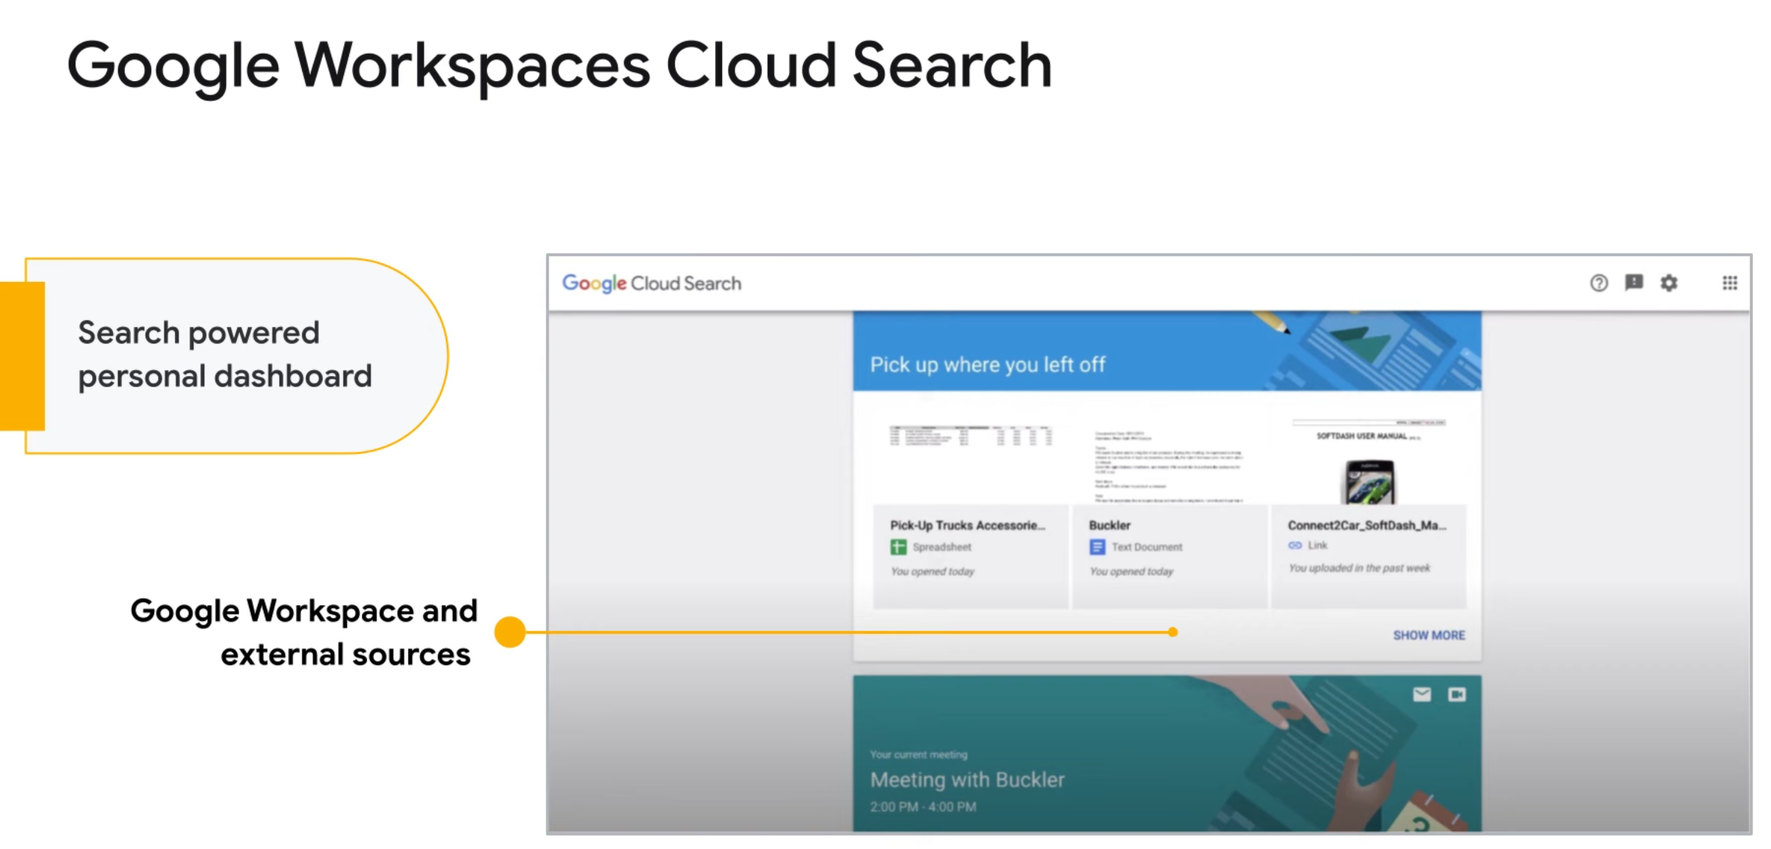

Slide 18
Retail Use Cases
Notes:
https://www.youtube.com/watch?v=CCNh3uOvaRA
https://www.youtube.com/watch?v=HYJnMkQQ2Ng
https://www.youtube.com/watch?v=WVlBLU9DBrY
https://www.youtube.com/watch?v=LdP_xdLmEPw
https://www.youtube.com/watch?v=3nR2hUaqqrU

Slide 19
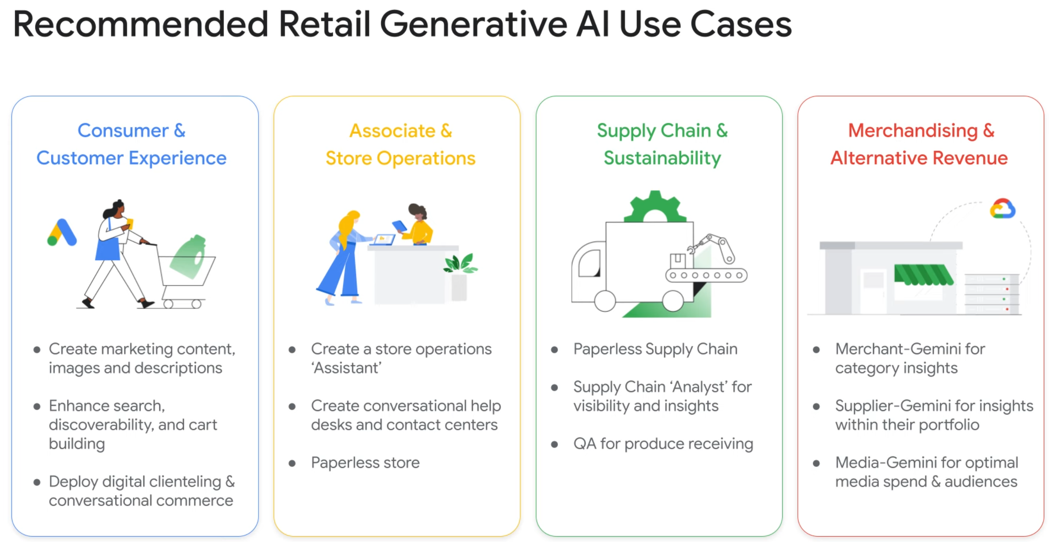

Slide 20
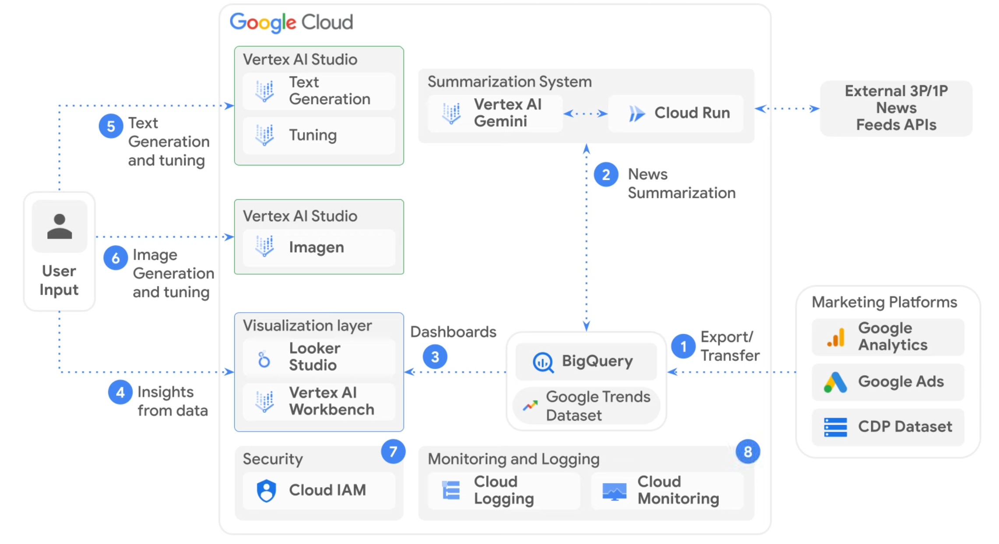

Slide 21
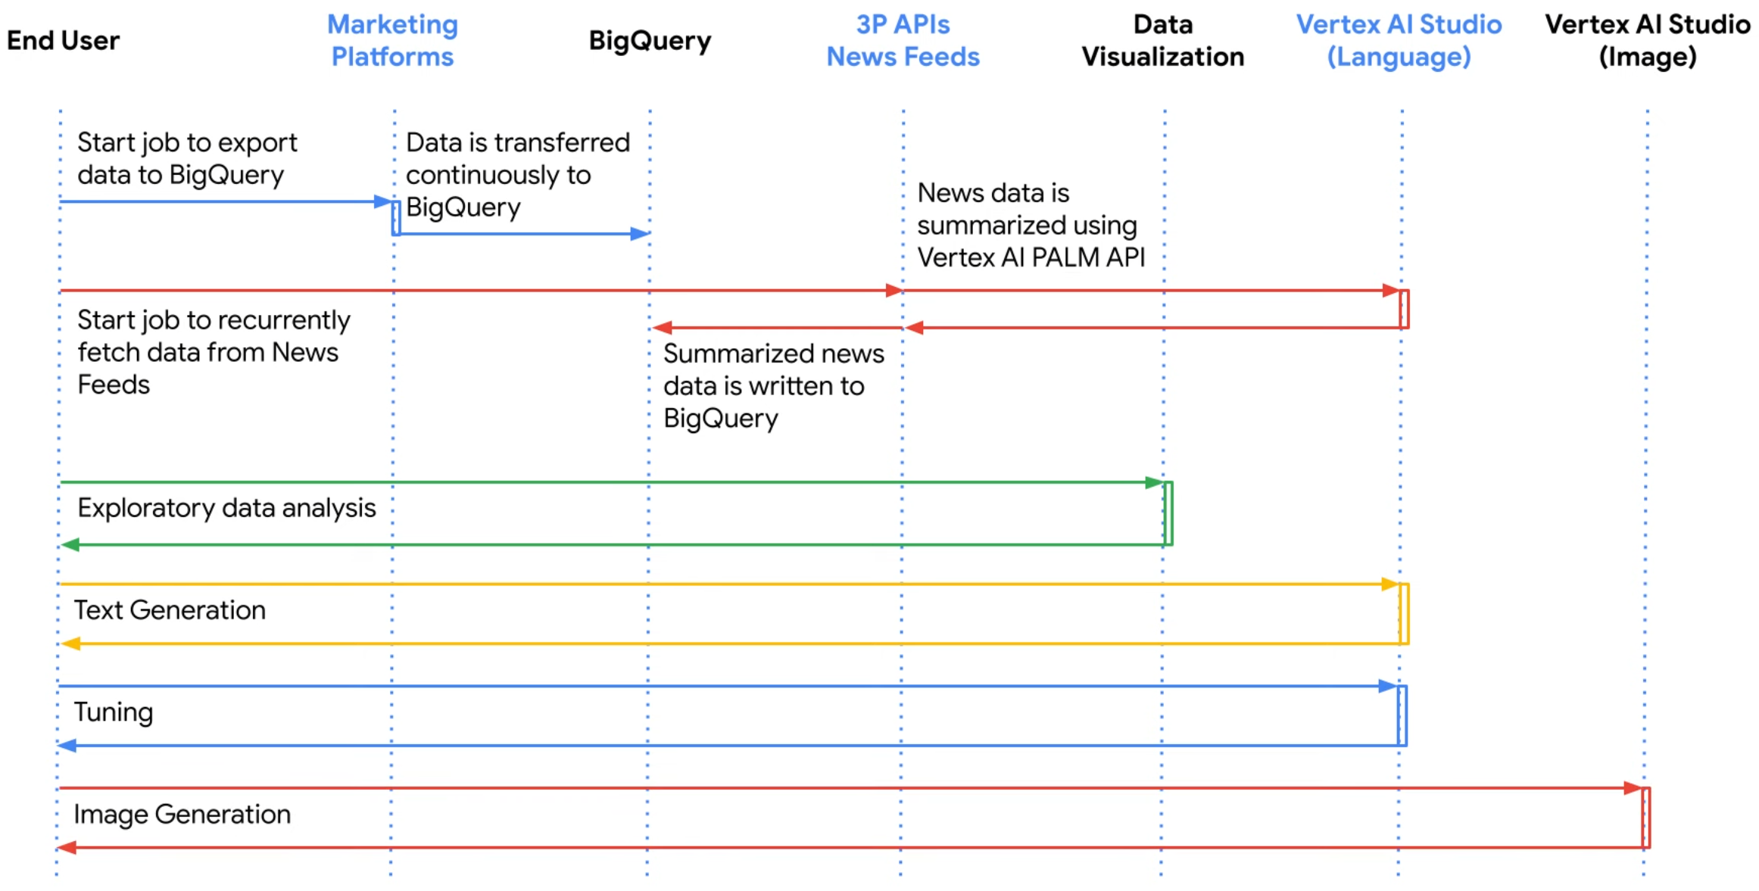

Slide 22
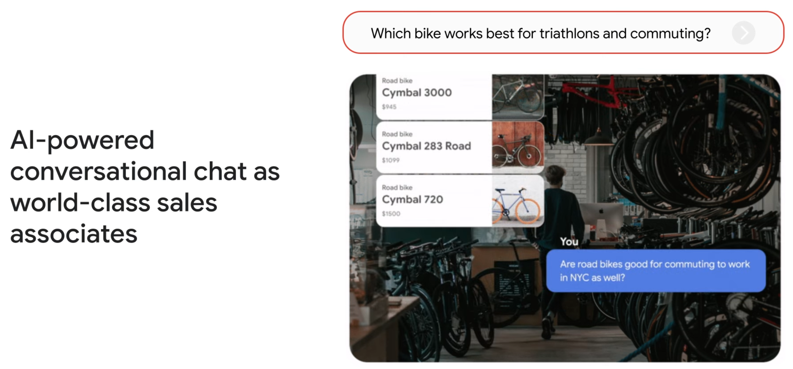

Slide 23
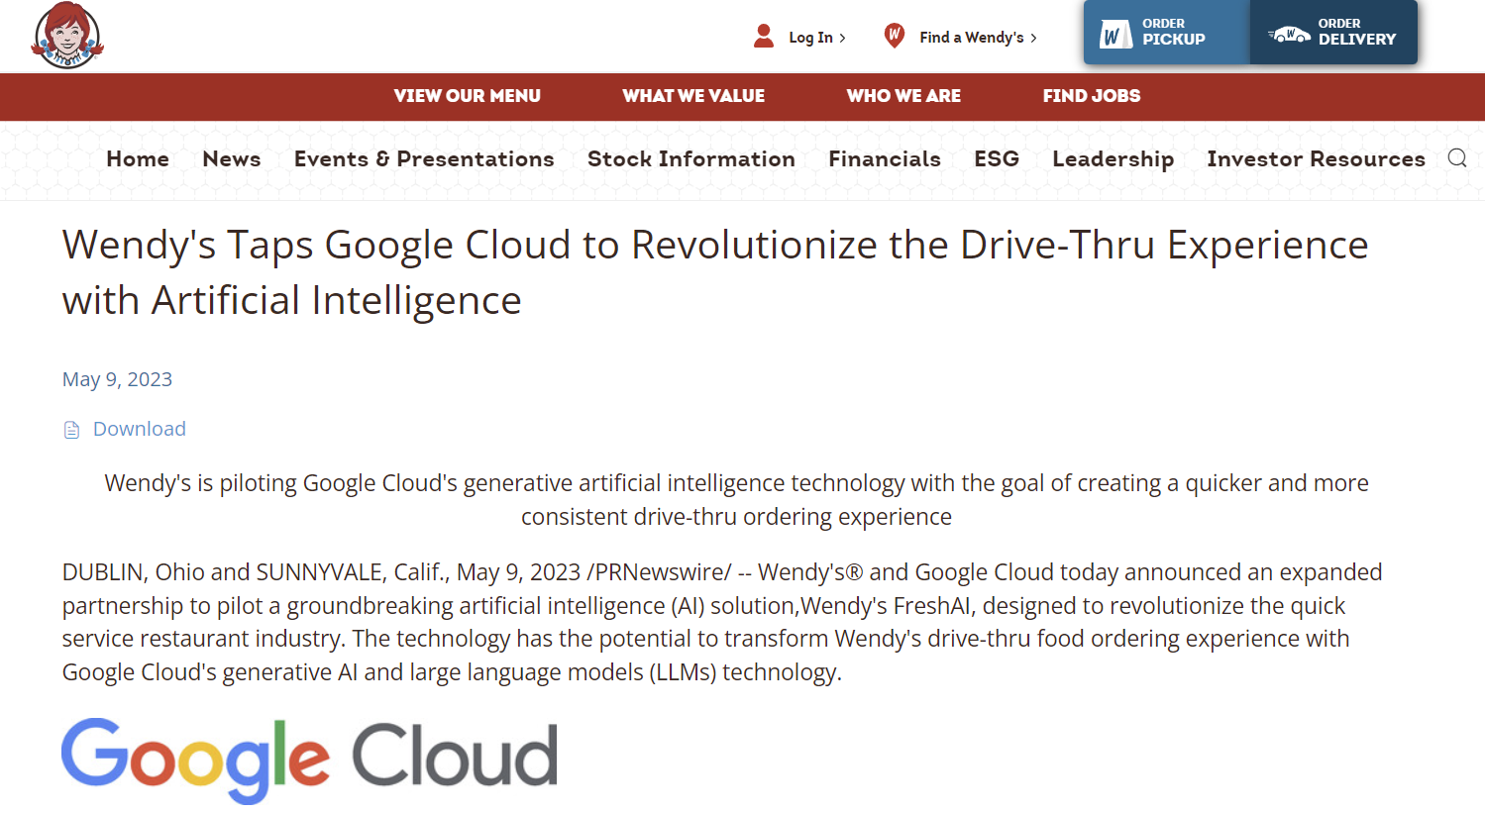
Notes:
https://www.irwendys.com/news/news-details/2023/Wendys-Taps-Google-Cloud-to-Revolutionize-the-Drive-Thru-Experience-with-Artificial-Intelligence/default.aspx

Slide 24
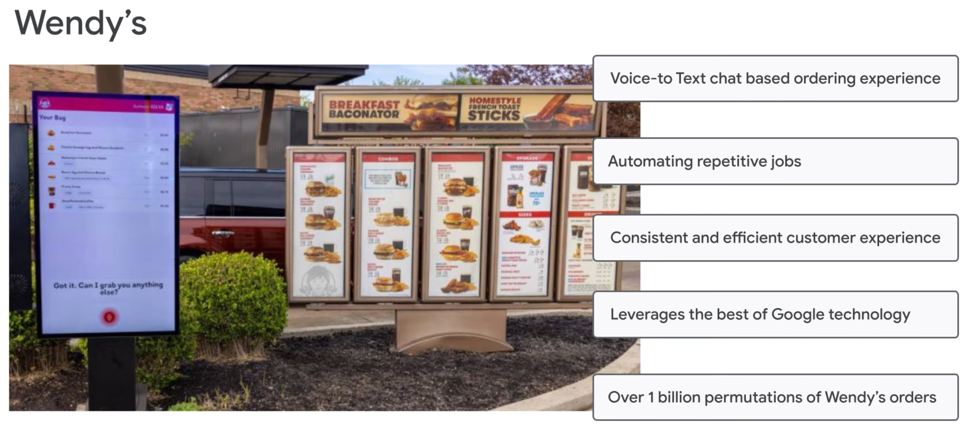

Slide 25
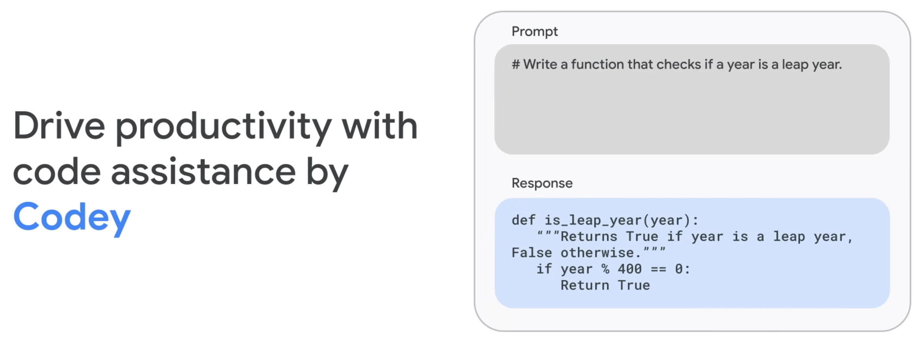

Slide 26
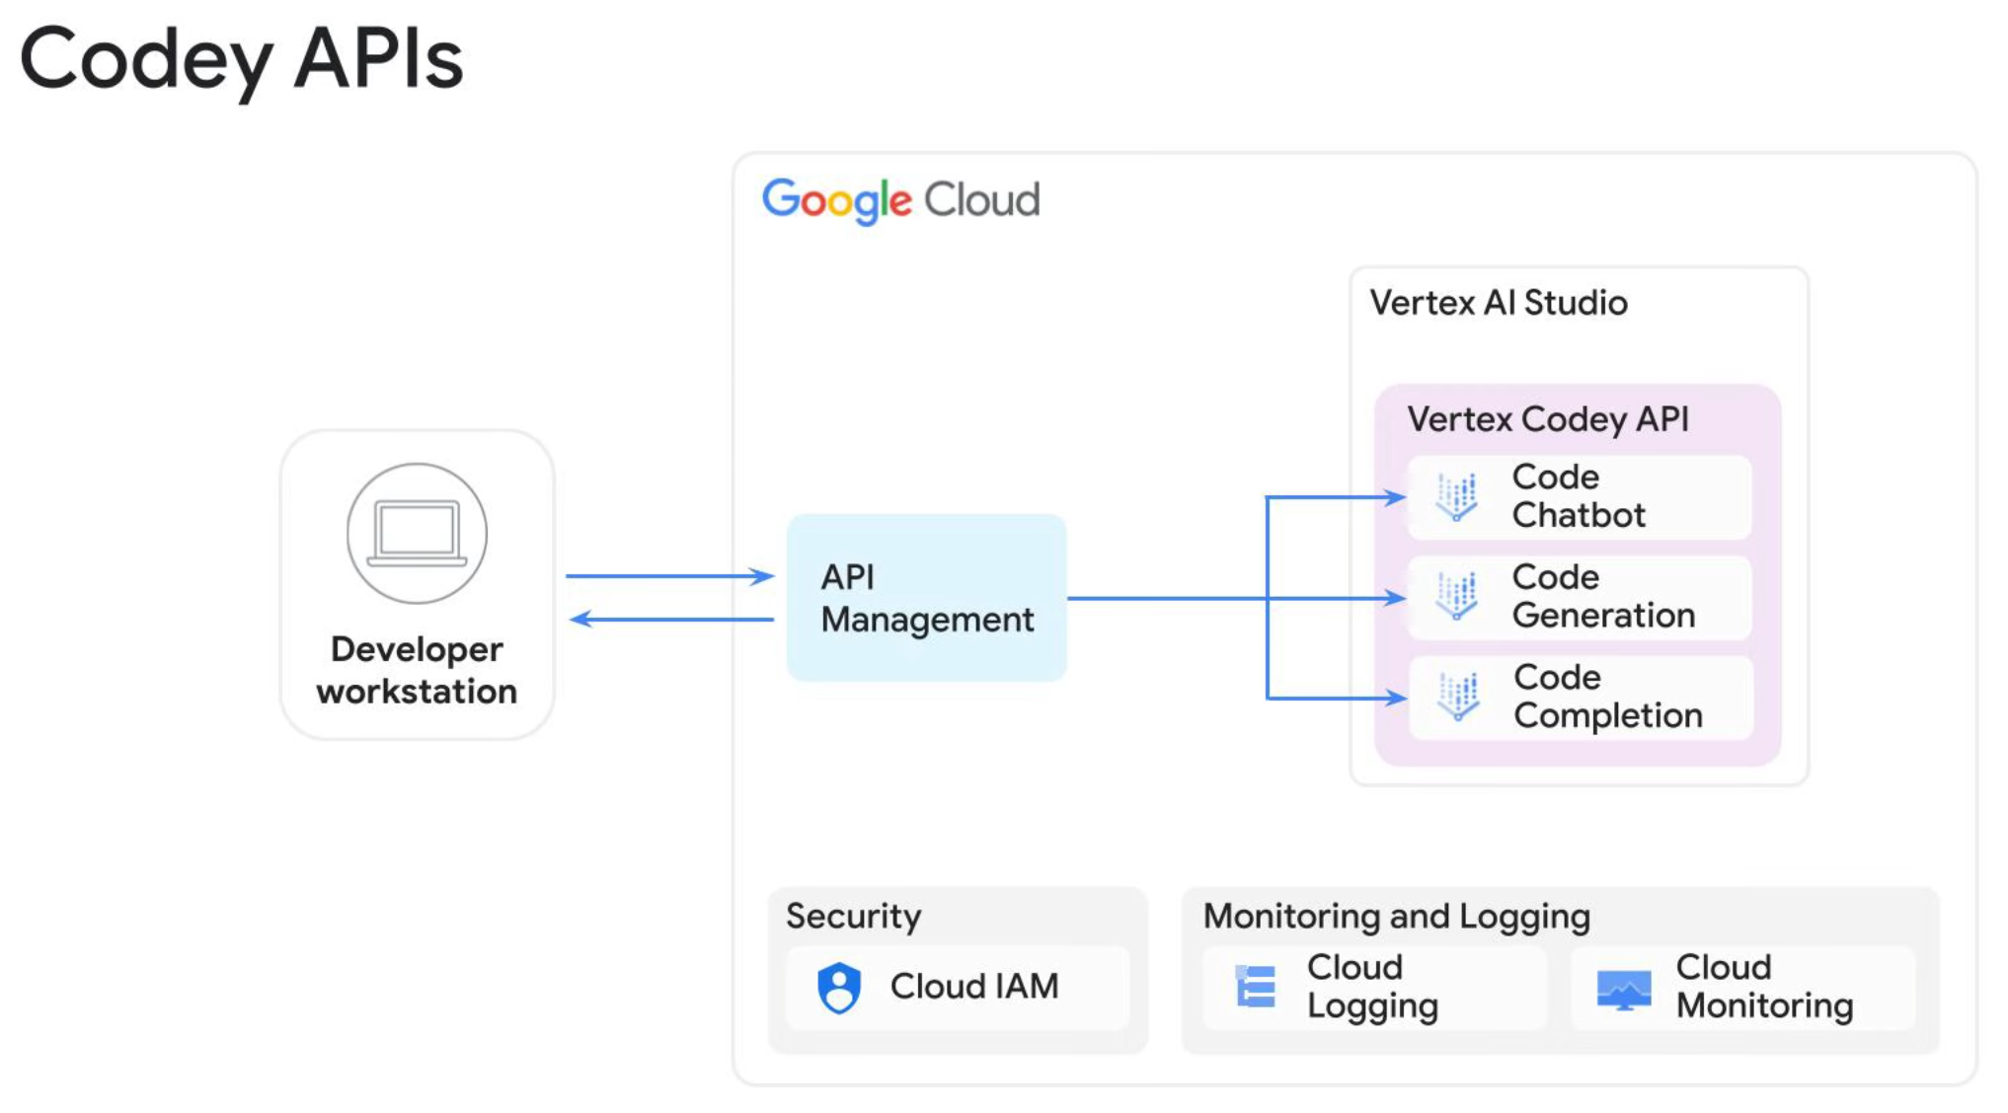

Slide 27
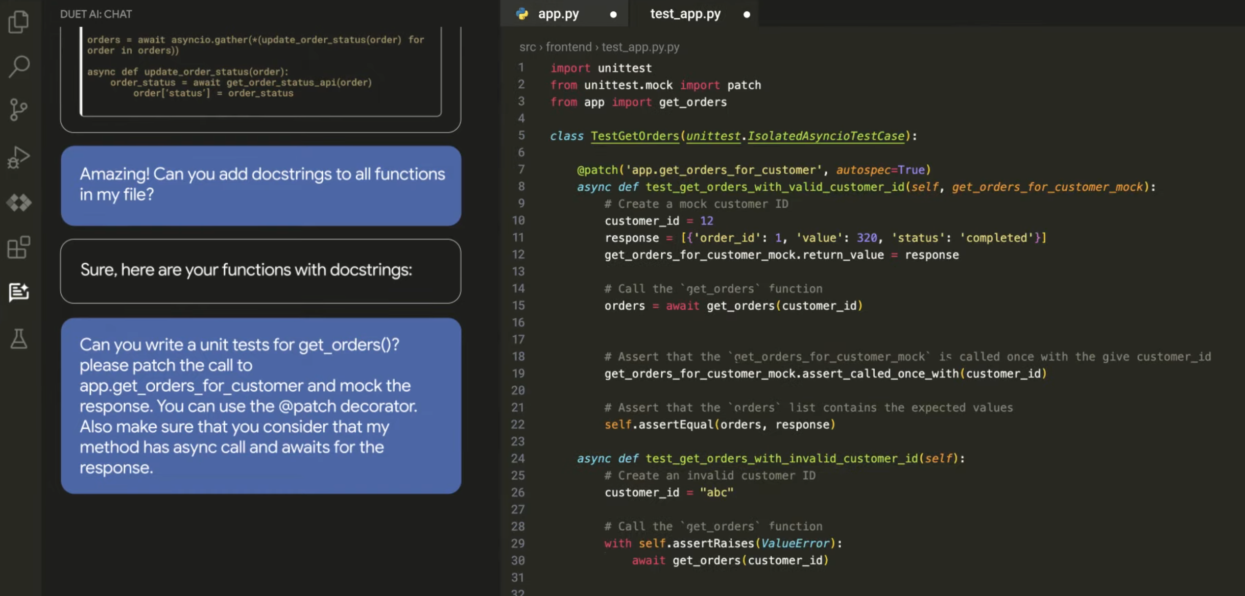

Slide 28


